Slide 1
similarity in networks
Similarity measures and their applications

Slide 2
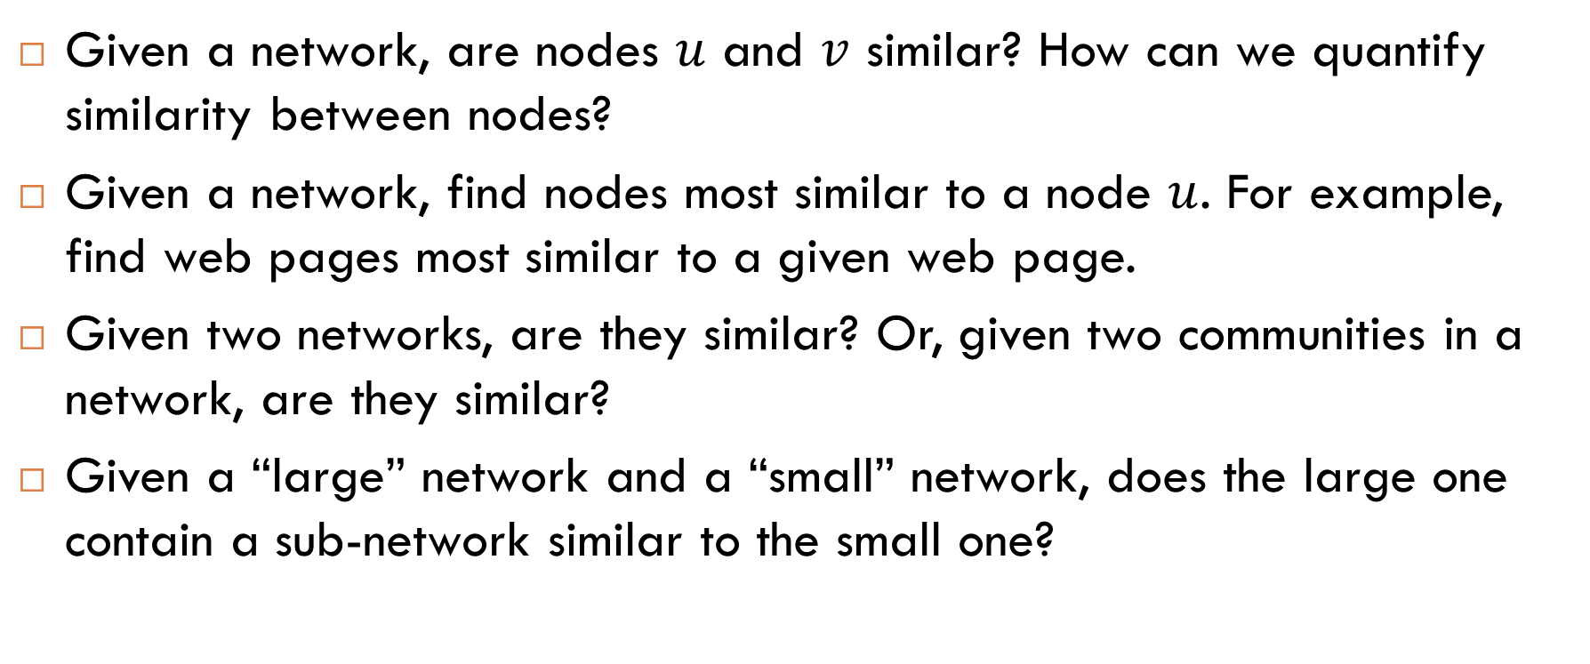
Examples of Questions About Similarity
Given a network, are nodes $u$ and $v$ similar? How can we quantify similarity between nodes?
Given a network, find nodes most similar to a node $u$. For example, find web pages most similar to a given web page.
Given two networks, are they similar? Or, given two communities in a network, are they similar?
Given a “large” network and a “small” network, does the large one contain a sub-network similar to the small one?

Slide 3
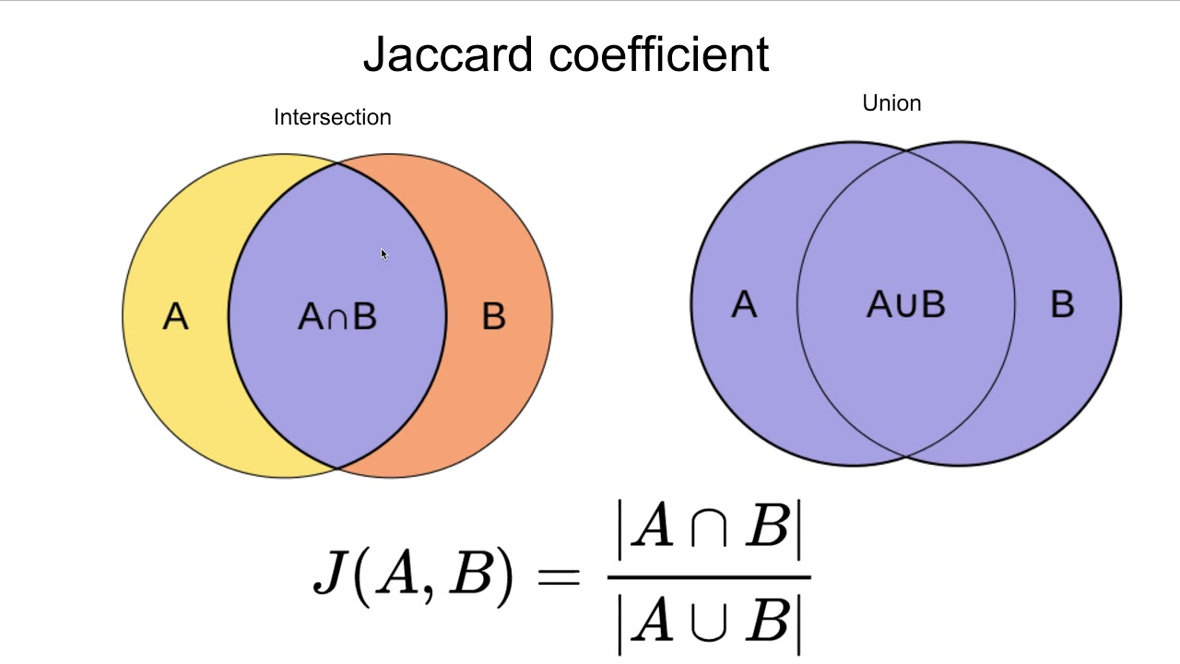

Similarity Between Sets
Question. How can you measure similarity between sets $A$ and $B$?

Slide 4

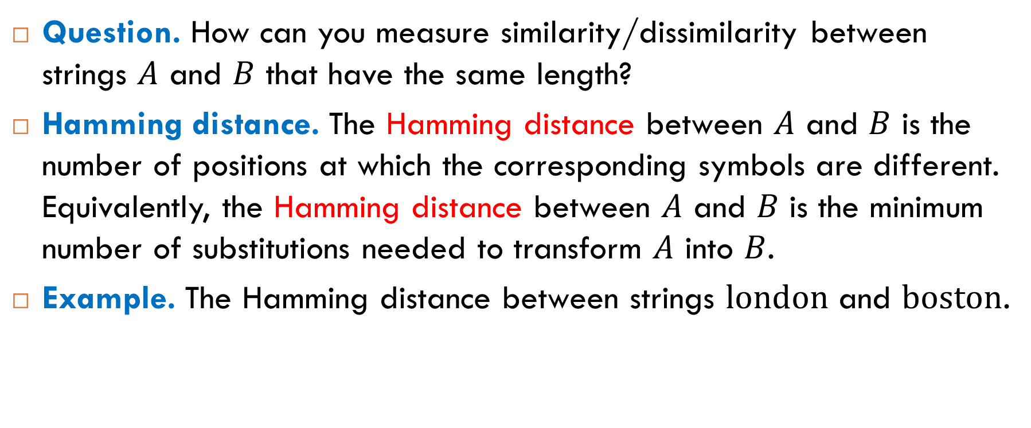
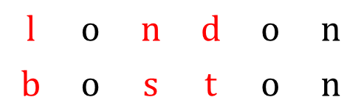
Similarity Between Strings of the Same Length
Question. How can you measure similarity/dissimilarity between strings $A$ and $B$ that have the same length?
Hamming distance. The Hamming distance between $A$ and $B$ is the number of positions at which the corresponding symbols are different. Equivalently, the Hamming distance between $A$ and $B$ is the minimum number of substitutions needed to transform $A$ into $B$.
Example. The Hamming distance between strings $\text{london}$ and $\text{boston}$.
$$\text{l}$$ | $$\text{o}$$ | $$\text{n}$$ | $$\text{d}$$ | $$\text{o}$$ | $$\text{n}$$
$$\text{b}$$ | $$\text{o}$$ | $$\text{s}$$ | $$\text{t}$$ | $$\text{o}$$ | $$\text{n}$$
$$H\left(\text{london},\text{boston}\right)=3$$

Slide 5
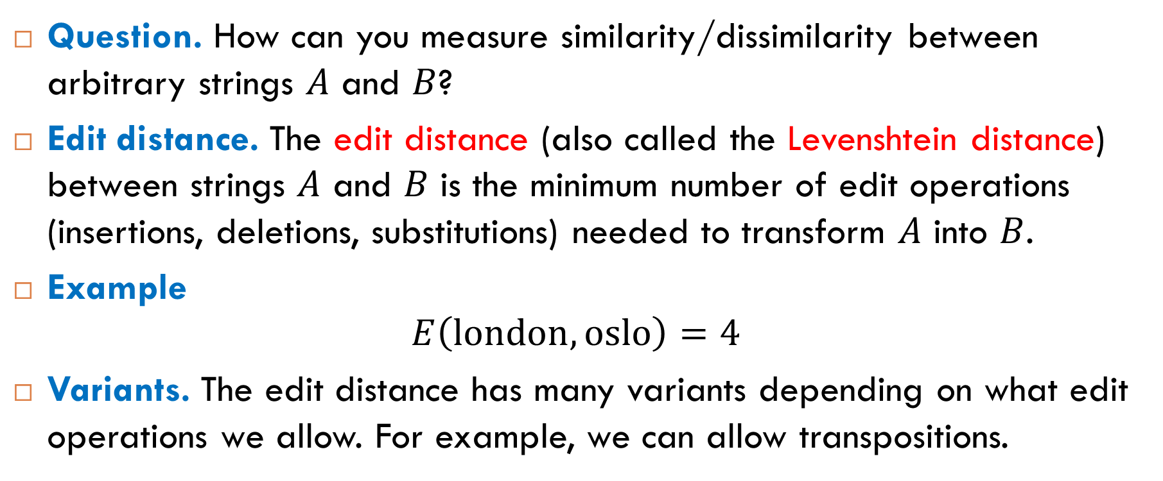
Similarity Between Arbitrary Strings
Question. How can you measure similarity/dissimilarity between arbitrary strings $A$ and $B$?
Edit distance. The edit distance (also called the Levenshtein distance) between strings $A$ and $B$ is the minimum number of edit operations (insertions, deletions, substitutions) needed to transform $A$ into $B$.
Example
$$E\left(\text{london},\text{oslo}\right)=4$$
Variants. The edit distance has many variants depending on what edit operations we allow. For example, we can allow transpositions.

Slide 6
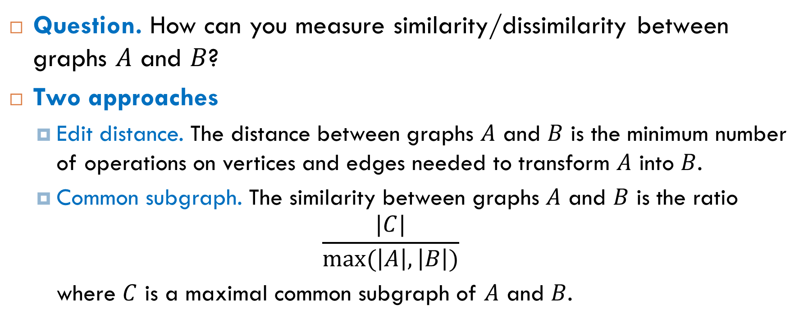
Similarity Between Graphs
Question. How can you measure similarity/dissimilarity between graphs $A$ and $B$?
Two approaches
Edit distance. The distance between graphs $A$ and $B$ is the minimum number of operations on vertices and edges needed to transform $A$ into $B$.
Common subgraph. The similarity between graphs $A$ and $B$ is the ratio
$$\frac{|C|}{max⁡(\left|A\right|,\left|B\right|)}$$
where $C$ is a maximal common subgraph of $A$ and $B$.

Slide 7
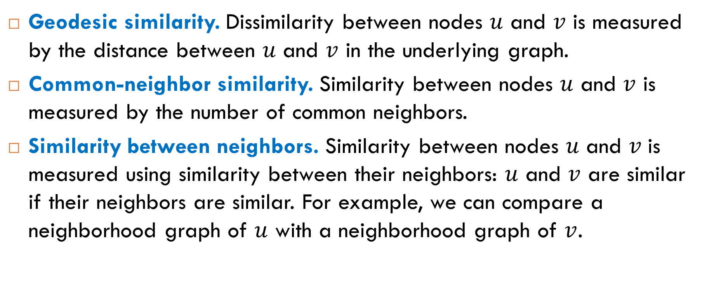
Similarity Between Nodes in a Network
Geodesic similarity. Dissimilarity between nodes $u$ and $v$ is measured by the distance between $u$ and $v$ in the underlying graph.
Common-neighbor similarity. Similarity between nodes $u$ and $v$ is measured by the number of common neighbors.
Similarity between neighbors. Similarity between nodes 𝑢 and 𝑣 is measured using similarity between their neighbors: $u$ and $v$ are similar if their neighbors are similar. For example, we can compare a neighborhood graph of $u$ with a neighborhood graph of $v$.

Slide 8
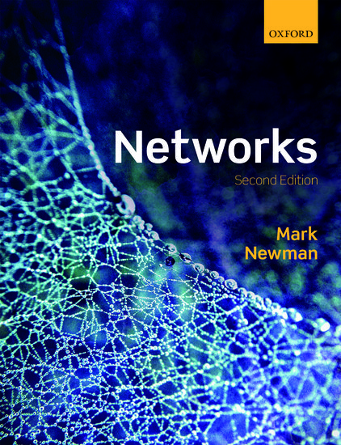
Reading
Section 7.6

